Slide 1


BachatBuddy: A Smart Personal Finance & Money Management App
Developed by: Team Rangers Course: Back End Engineering-II - 23CS008 Instructor: Mr. Deepak Kumar

Slide 2

The Problem: Navigating Personal Finance
Many individuals, particularly students and young professionals, face significant challenges in managing their personal finances effectively. These struggles often manifest as:
Difficulty in consistently tracking expenses.
Struggling to create and stick to a budget.
Inconsistent savings habits.
Existing financial applications are often too complex, overly generic, or lack the specific gamified and localized (INR) features needed to motivate and engage users.

Slide 3




Project Objectives
BachatBuddy aims to address these challenges by providing a comprehensive yet intuitive personal finance management solution. Our core objectives are to:
Multi-User Tracking
Effective Budgeting & Saving
Develop a robust web application supporting individual accounts for secure and personalized finance tracking.
Empower users to track income, categorize expenses, and set realistic savings goals with ease.
Gamified Motivation
Actionable Insights
Integrate gamification elements like points, challenges, and leaderboards to foster consistent financial habits.
Provide clear visualisations and projections for informed financial planning and decision-making.

Slide 4

Project Development Phases
Phase 1: Core Functionality &
Budgeting
Phase 2: Enhanced Reporting & Goals
Phase 3: Advanced Gamification & AI
Focus on essential expense tracking, categorisation, and basic budgeting features.
Implement debt tracking, advanced reporting, and initial saving goal functionality with a points system.
Integrate gamified leaderboards, future financial projections, and AI-powered insights.

Slide 5
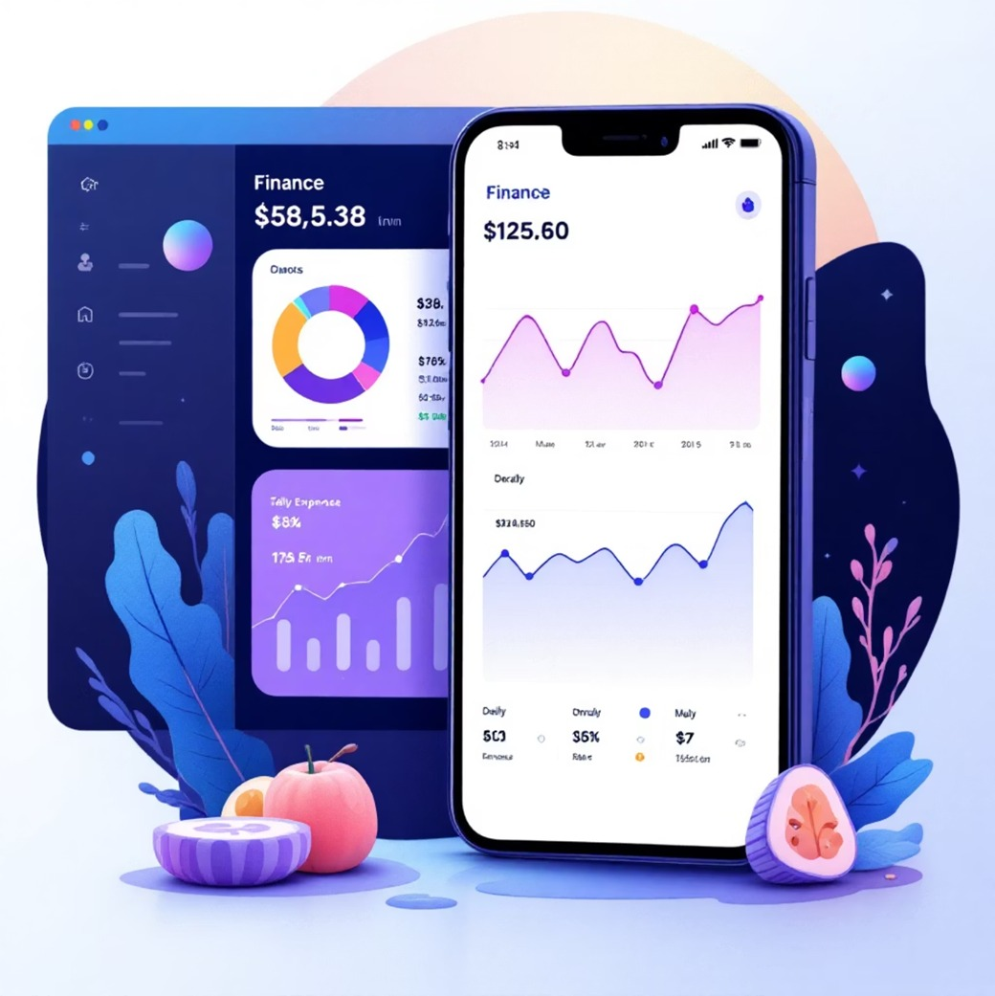
Phase 1: Core Tracking & Budgeting
Phase 1 establishes the foundational elements of BachatBuddy,
Allowing users to effectively track their financial transactions
and manage their spending.
Smart Expense Categorisation: Automated and manual categorisation of transactions.
Wallet Tracking: Separate tracking for cash and digital wallets.
Spending Insights: Visualisations (donut charts, bar graphs) to understand spending patterns.
Budget Alerts: Real-time notifications for budget breaches.
Recurring Transactions: Automated management of regular income and expenses.

Slide 6
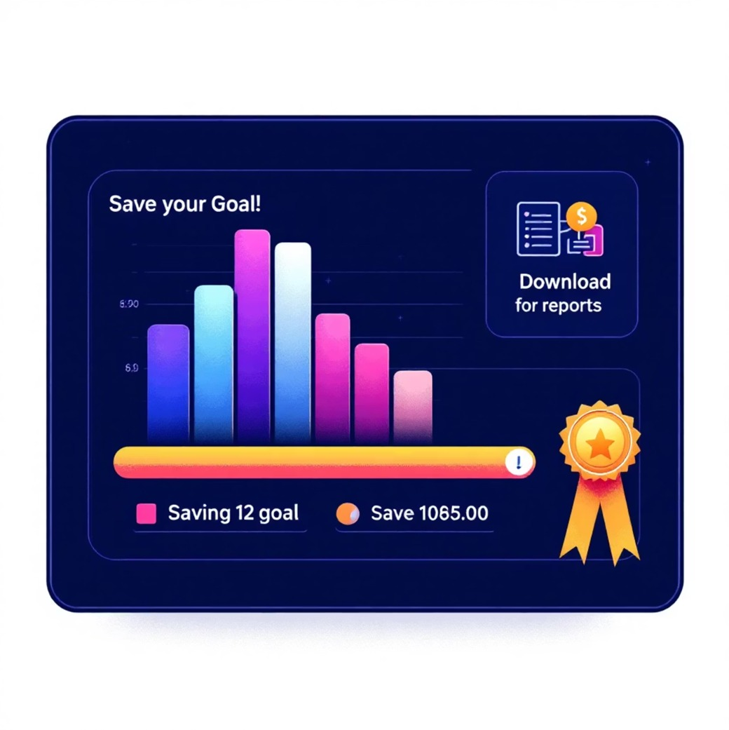
Phase 2: Enhanced Features
Building upon the core, Phase 2 introduces tools for deeper
financial management, including debt management, detailed
reporting, and the initiation of our gamification system.
Debt & Loan Tracker: Comprehensive module to monitor and manage outstanding debts.
Exportable Reports: Manual CSV/PDF generation of
financial summaries for external use.
Savings Goals: Users define and track progress towards specific financial objectives.
Points System: Introduction of points awarded for positive
financial habits, laying groundwork for gamification.

Slide 7
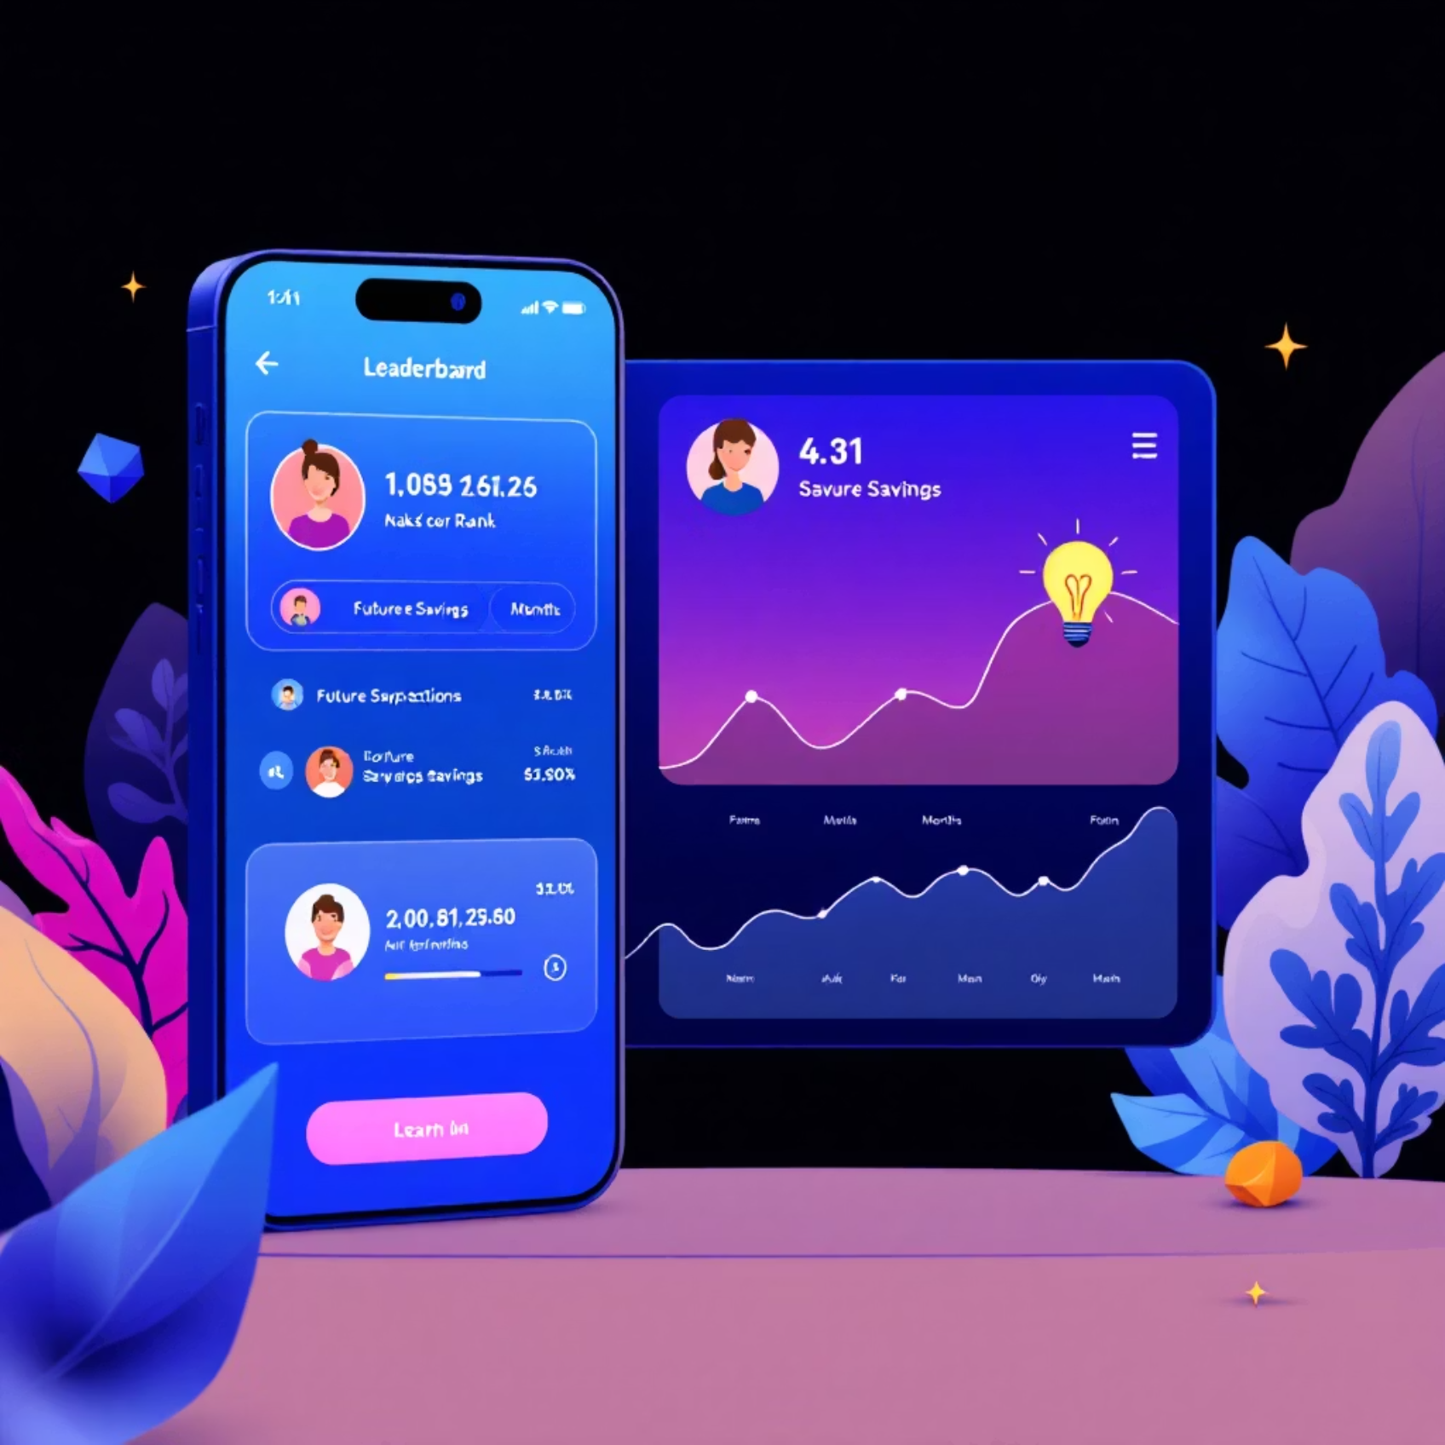
Phase 3: Advanced & Gamified Features
The final phase elevates BachatBuddy to a truly engaging and
predictive tool, integrating advanced gamification and
intelligent insights.
Gamified Savings Leaderboard: Competitive element driving user engagement and motivation.
Future Savings Projection: Predictive insights for overall
and per-goal savings, based on 3-month average performance.
AI-Powered Insights: Initial rule-based financial advice, with future scope for Large Language Model (LLM) integration.

Slide 8
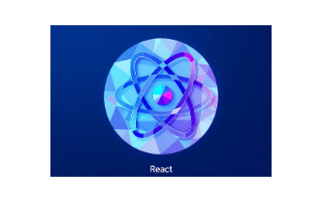










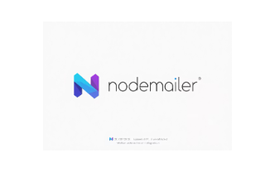



Technical Architecture: The MERN Stack
BachatBuddy is built on a robust and scalable MERN (MongoDB, Express.js, React, Node.js) stack, complemented by a suite of modern development tools.
Frontend: React with Vite for fast development and Tailwind CSS for styling.
Backend: Node.js with Express.js handling API logic.
Database: MongoDB Atlas via Mongoose for flexible data storage.
Key Tools: Node-cron for scheduled tasks, Recharts for visualisations, Joi/Zod for validation, JWT/bcrypt for authentication, Nodemailer for email alerts, and Swagger for API documentation.
Deployment: Vercel for the frontend, Render for the backend, and MongoDB Atlas for the database.

Slide 9
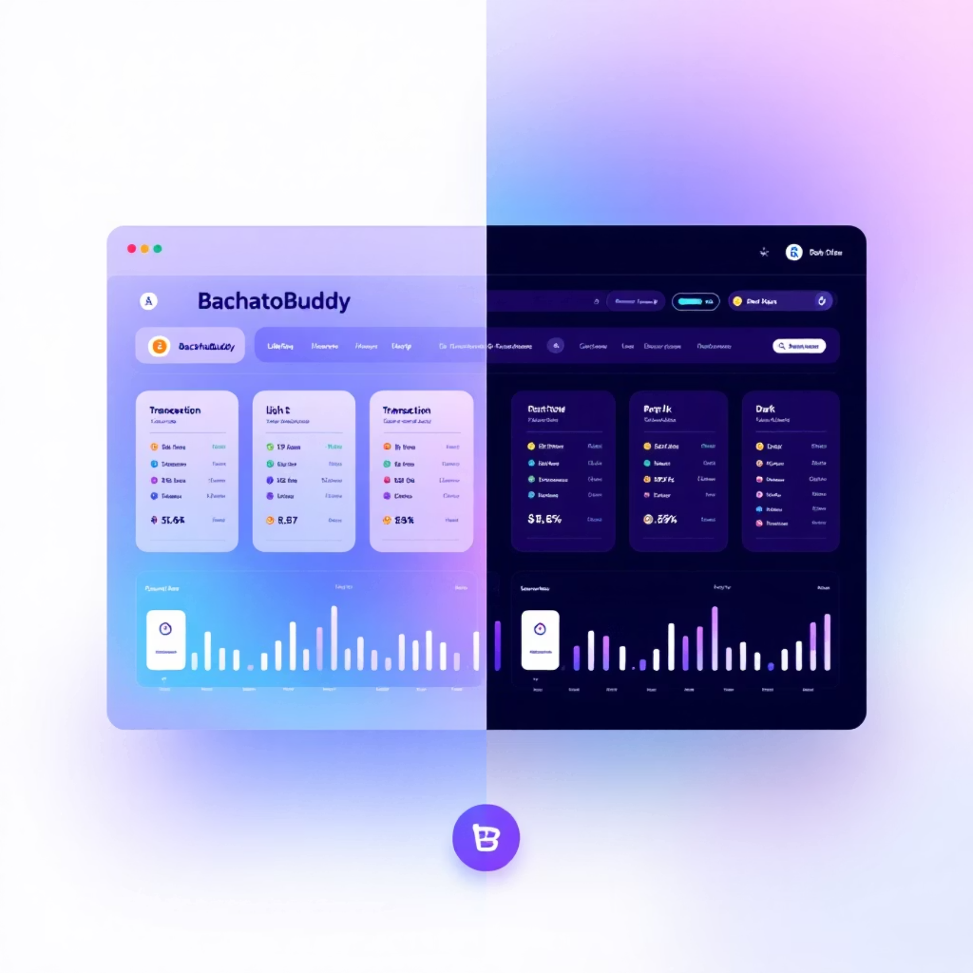
Unique Highlights & UX
BachatBuddy stands out with features designed for immediate
relevance and enhanced user experience:
Localized Currency: Default transactions and reporting in Indian Rupees (₹).
Multi-User System: Secure, isolated accounts from day one.
Dark Mode Option: Enhanced UI experience for varied preferences and reduced eye strain.
Academic & Practical Relevance: Encourages real-world
financial literacy among students and young earners.

Slide 10

Conclusion & Future Directions
BachatBuddy is envisioned as a practical and engaging tool, fostering financial literacy and discipline. Its phased development ensures a robust backend and a feature-rich user experience.
Evaluation Relevance:
Demonstrates comprehensive MERN stack concepts.
Implements real-world features through iterative development.
Future Scope:
Mobile application development.
AI chatbot advisor for personalised financial guidance.
Automated email report generation.

